Slide 1
Splines in ADMB and Stock Synthesis
Ian Taylor
Fisheries Think Tank
Nov. 8, 2011

Slide 2
Understanding splines in ADMB
Splines have long existed in ADMB, but it was not easy to learn how to use them.
Email discussion in October, 2010 provided some example code from Mark Payne with help from Derek Seiple.
Understandable best by trying an example
Implemented in Stock Synthesis in spring of 2011.
For more info, seehttp://admb-project.org/documentation/faq#splines

Slide 3
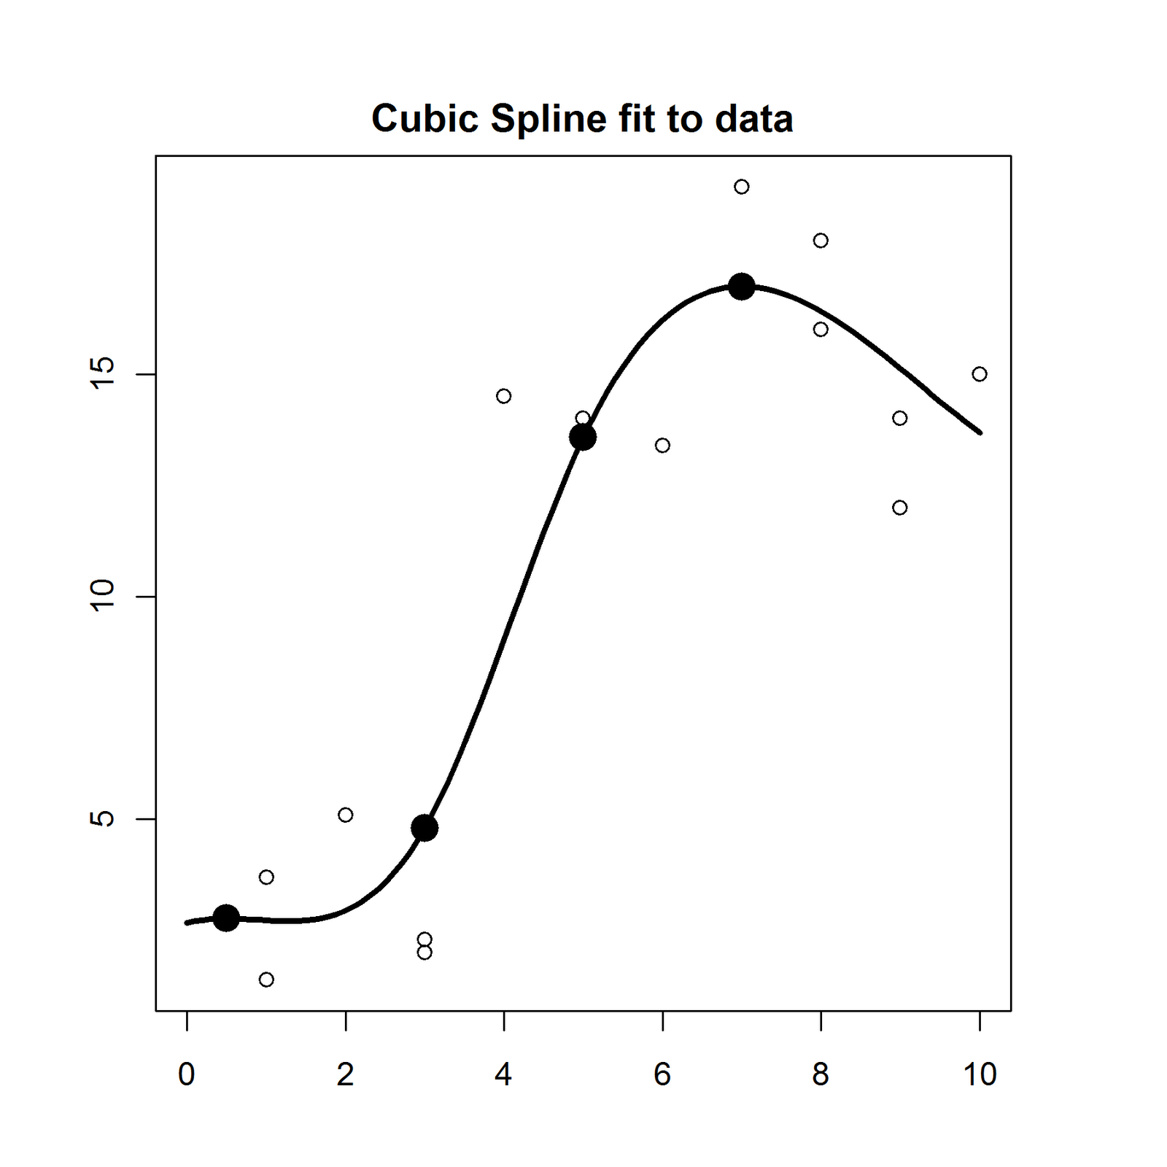
Understanding splines in ADMB

Slide 4
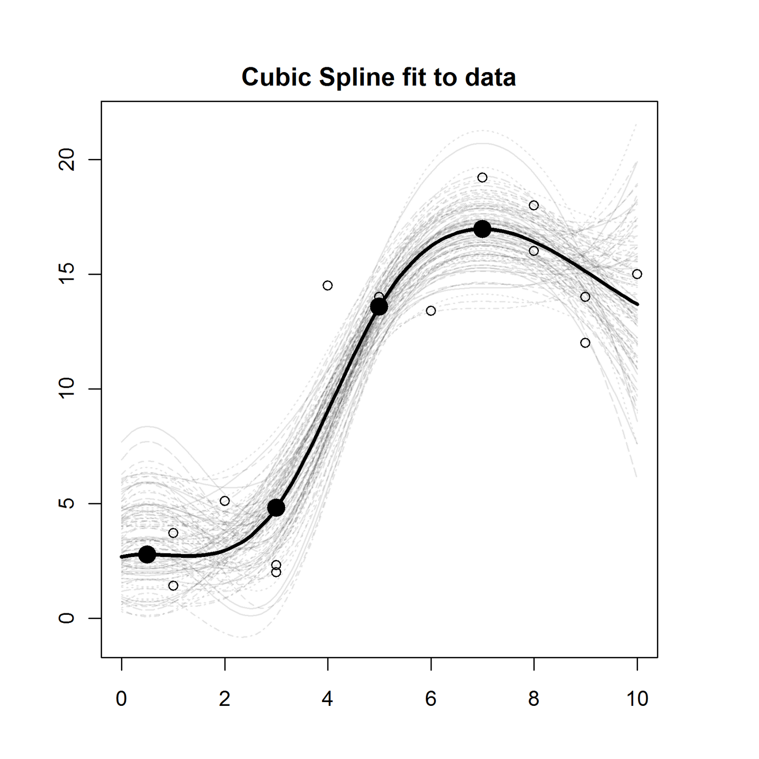
Understanding splines in ADMB

Slide 5
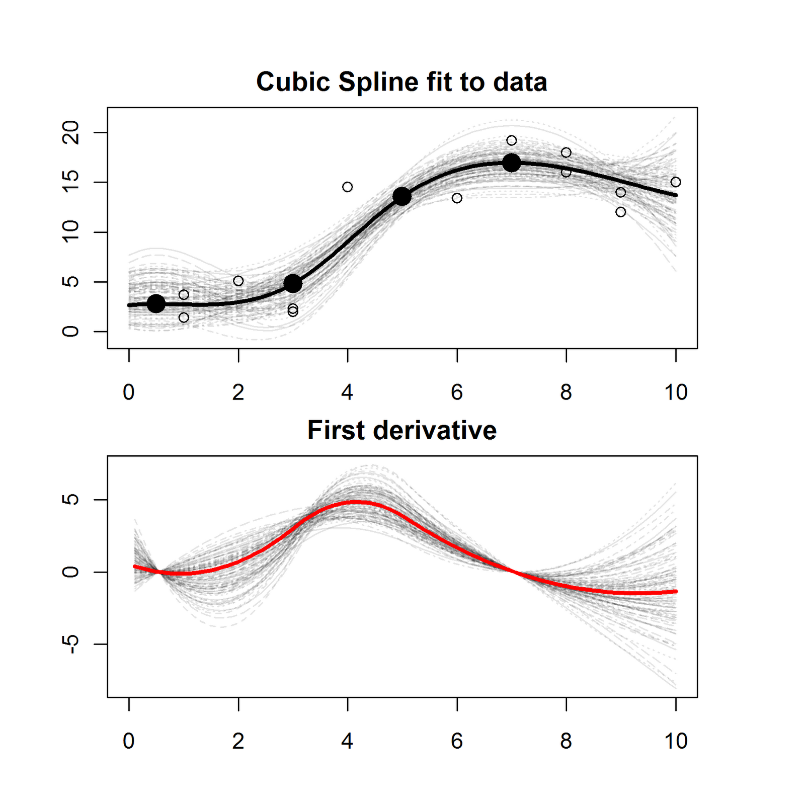
Understanding splines in ADMB

Slide 6
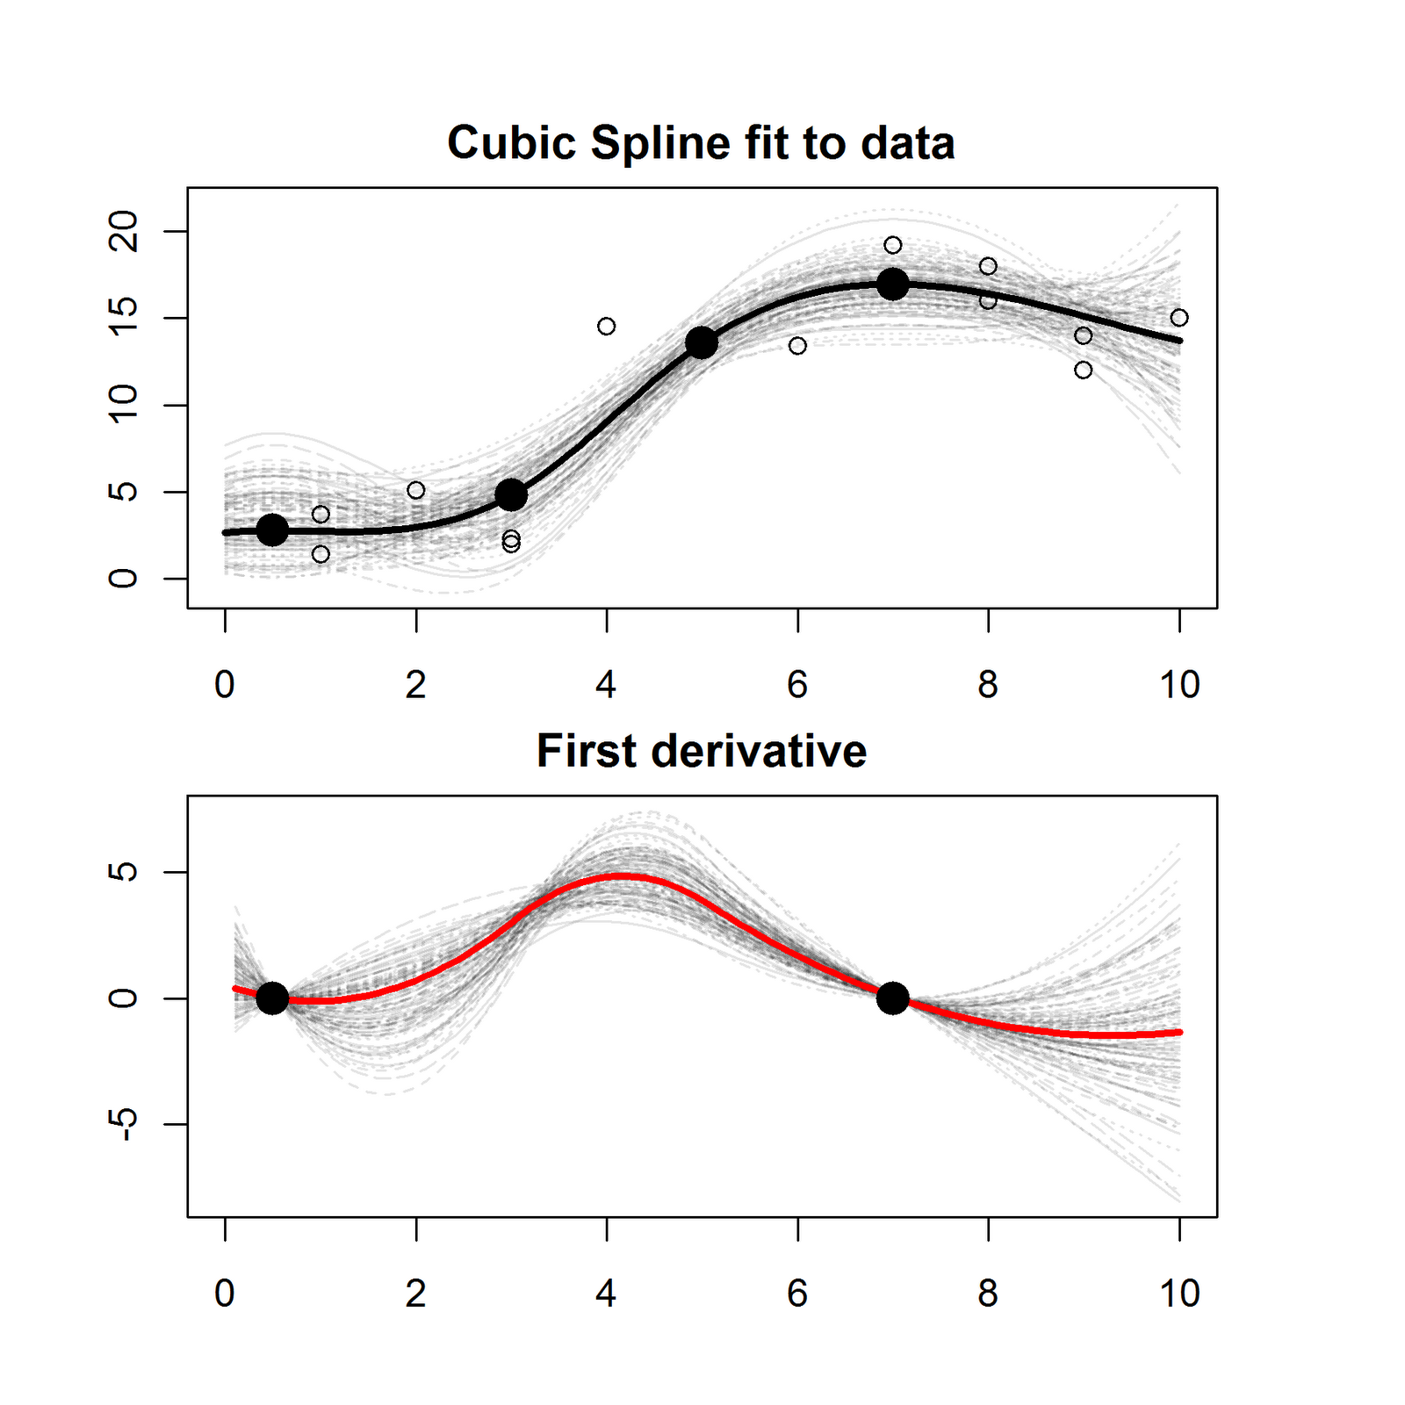
Understanding splines in ADMB

Slide 7
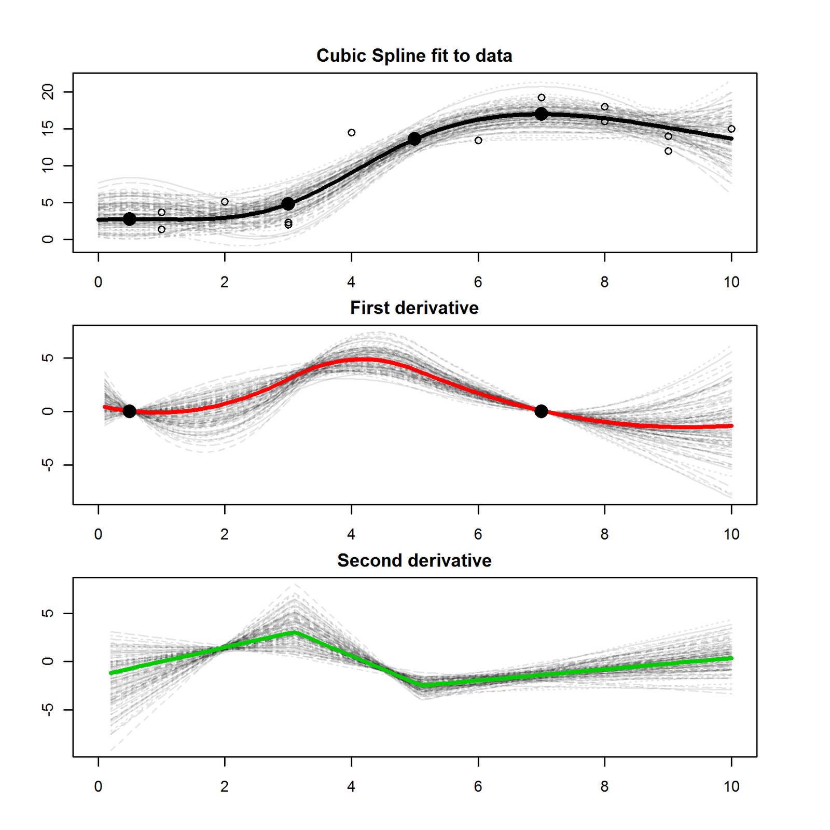
Understanding splines in ADMB

Slide 8
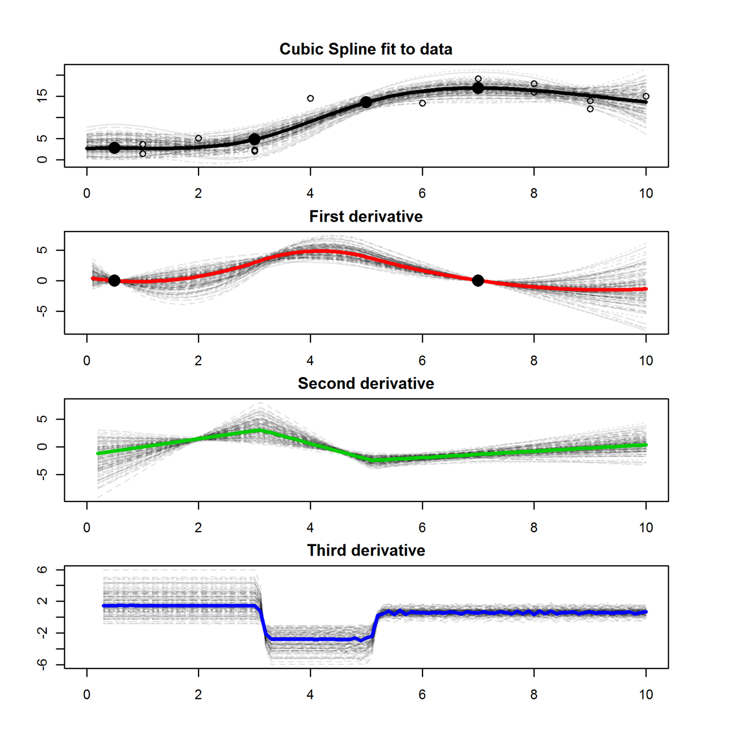
Understanding splines in ADMB

Slide 9
Understanding splines in ADMB

Slide 10
Exploring splines
R function “selfit_spline” based on work of Tommy Garrison:
library(r4ss) update_r4ss_files()
selfit_spline(n=4, dir='c:/test/')
Could not replicate ADMB’s spline calculations in R late on Friday afternoon.
But there’s a better way…

Slide 11
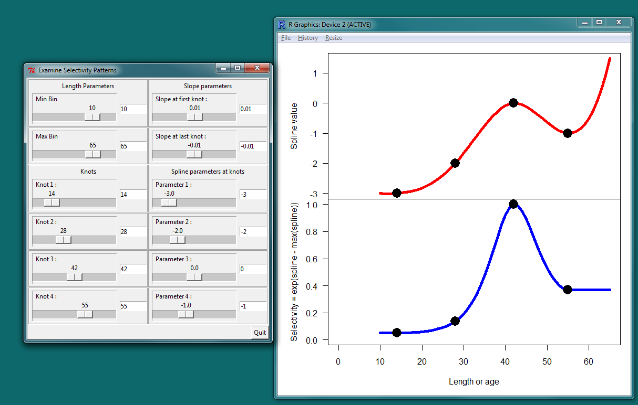
Run example

